Slide 1


IPL 2021 Analysis Dashboard
Presented By:-
Pratik Bhushan Deore

Slide 2
Overall, which Team Has The Highest Win Percentage?
Chennai Super Kings has the highest win percentage.
With help of pie-chart we can easily rectify with help of percentage

Slide 3
Which bowlers have taken the most wickets in season?
HV Patel has taken the most wickets in season as compare to others.
Avesh Khan is 2nd most wicket taken in season.

Slide 4
In Which Venue Stadium is Booked for Playing IPL?
Dubai International Cricket
Stadium is Most Booked Stadium For Playing 2021 IPL – 3149
Zayed Cricket Stadium,
Abu Dhabi Venue Place Have less Booking for Playing Match - 1874

Slide 5
In Which Month Most IPL Match Played?
In the Month of April IPL Match is Played Mostly – 6293 Match
Also In May Month have Less Matches was Played

Slide 6
In Inning How Many Total Runs Taking by Batting Team?
In First Inning Chennai Super King takes 1812 Runs
In Second inning Chennai Super King takes 921 Runs

Slide 7
Which batters have scored the most runs in season?
RD Gaikwad Has Scored the Most Runs in Season with 658.
F D Plessis is 2nd Most Runs Taken in Season With 657.

Slide 8
Which City is Famous for Played IPL?
Dubai is Famous city for Most Held Matches for IPL 2021--3149
Delhi City is Less Held for IPL Matches of IPL 2021-- 988

Slide 9
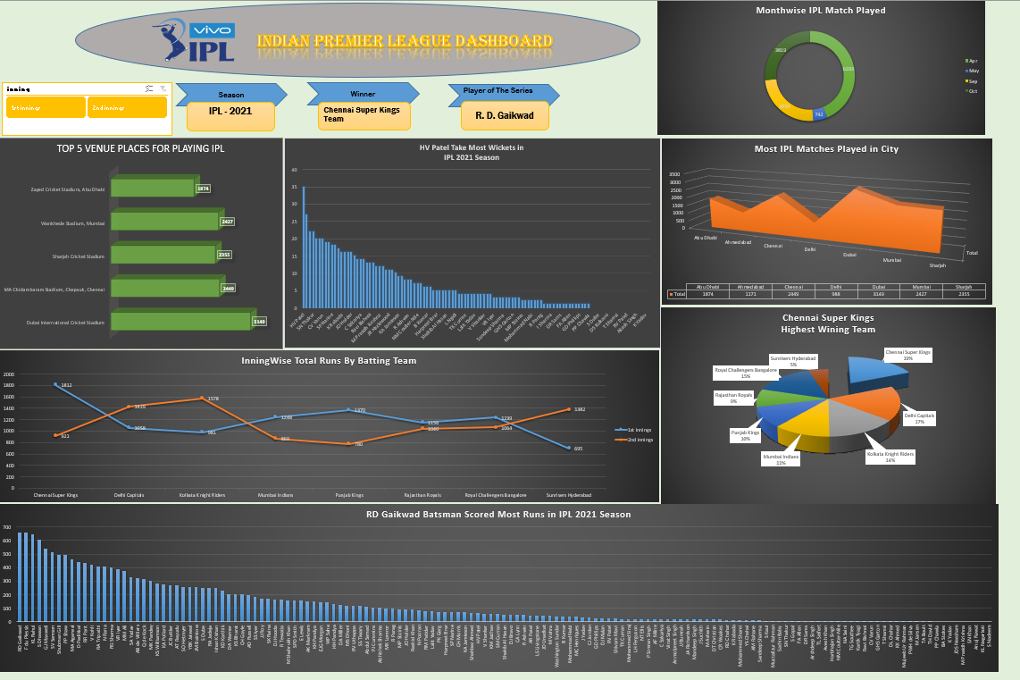
IPL 2021 Dashboard

Slide 10
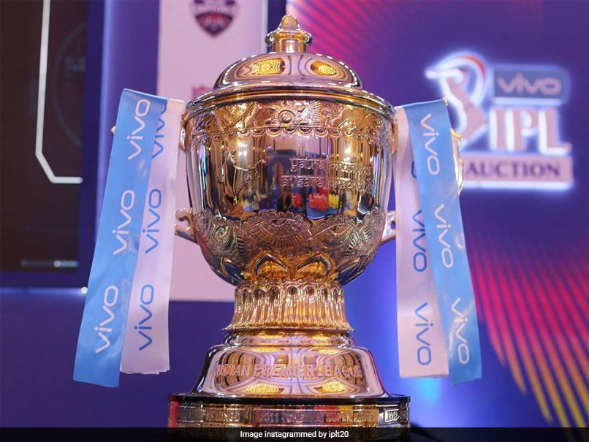

Thank you
Any Question??

